Slide 2
Requirements to be met
During modeling of product following things are held in mind
1. Shape element should not only acts like a geometric feature it should have technical information. For example a hole should not only be like a circle it should have features of hole.
2. The same model should be made compatible to be used in different departments for eg it should be used for design optimization and it should be used for manufacturing of the part. So while drawings are issued for different departments the changes that should be done on the model should be minimum

Slide 3
Steps followed to met the requirements
Parametric modeling
Feature modelling

Slide 4
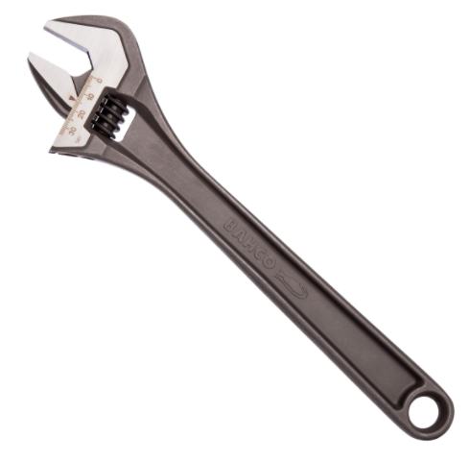
Part Modeling
Component selected for Modelling is Adjustable wrench also known as crescent wrench
It has 4 parts
Main body
Moving jaw
Screw
Pin
The software used for modeling is NX
Fig: Adjustable Spanner

Slide 5
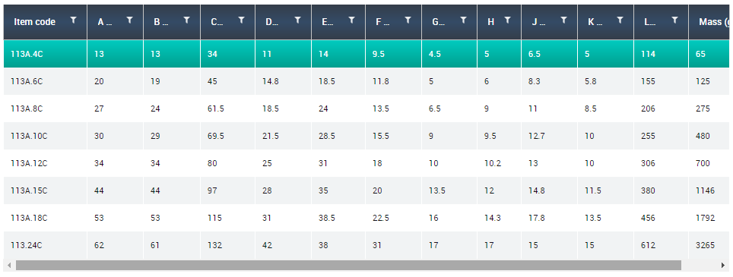
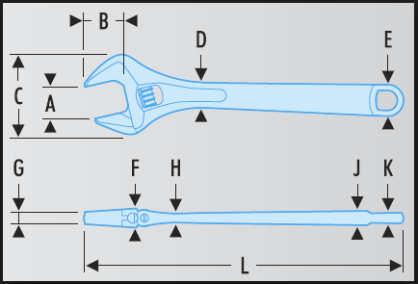
Modeling of Part – Parametric modeling
Fig: Dimension of the parts
From a Product catalogue of a manufacturer^{[1]} some of the dimensions of the wrench are taken

Slide 6
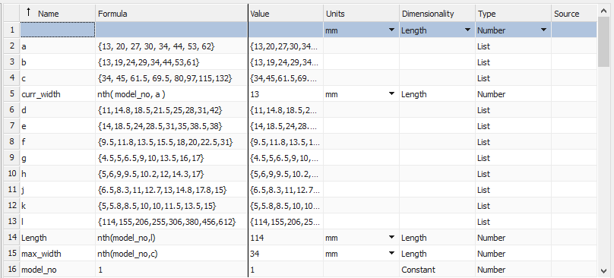
Modeling of Parts – Parameter introduction
In-order to make one model for all their products parametric modeling of the parts is required this is done by the following way.
Listing possible values
Model number variable
Look up table.
Fig: Creation of Parameters in NX

Slide 7
Modeling of Parts – Parameter introduction
From one main parameter (here maximum size of the bolt head that can be hold) parameter A all other parameters are derived.
Using the table value and fitting a polyline of order 2 relationship with all the other parameters are calculated from this relation between variables other variables are derived.
These parameters are then can be extracted to the NX expression
This process has following advantages
Instead of making only for particular set of model types we can have infinite number of model. So this model is better if a design analysis need to be done.
By this method we can involve expression relation between parameter which are more than order1 (NX expression does not allow for Quadratic or cubic expression if the two parameters are of same dimension( example length of the part) .

Slide 8
Modeling of parts – General procedure followed
Top down approach is followed.
All dimensions are made in reference with the parameters defined.
While making the parts features are used thinking of manufacturing. for example instead of drawing circle and extrude, hole feature is used.
All the extrude option the end point is given with reference to the surface end.
While making any sketch it is ensured that the sketch is fully constrained and there is no auto constrained available and the dimensions for constraining is also a parameter.

Slide 9
Modeling of part – Part 1

Slide 10
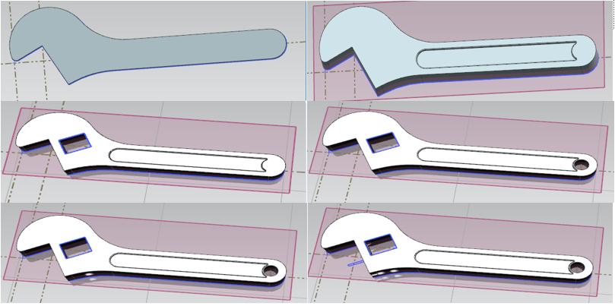
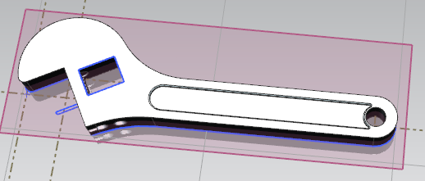
Modeling of part – Part 1
Fig: Part 1 Main Body of the Adjustable spanner
Fig: steps involved in making of part 1

Slide 11
Modeling of parts – steps in making part1
Cutting to shape from rectangular block and while drawing the shape all the dimensions in the figure (including the dimensions for constraints) are made from parameters.
Drill feature is used to make the drill the drill depth is given till the face instead of specifying the drill depth. And also the centre point of the drill is constrained with a distance which is a parameter which depends on the model number of the part.
Cut is made for the screw by extrude and subtract cut depth is given till the bottom face.
After drawing section it is cut for moving jaw movement while extruding it is ex-truded till the face.
drill is made for the pin insertion till the side face of the main part.

Slide 12
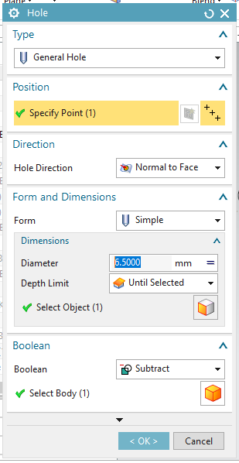
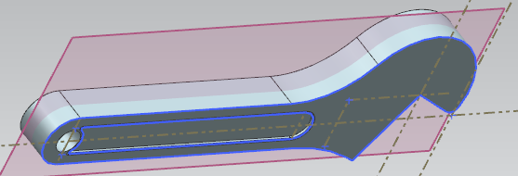
Modeling of parts – part 1
Fig: Shows the specifying drill depth for the part

Slide 13
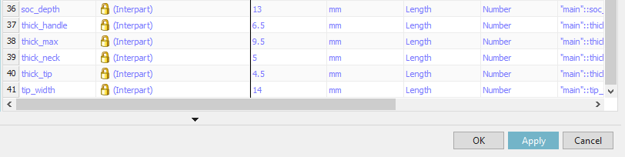
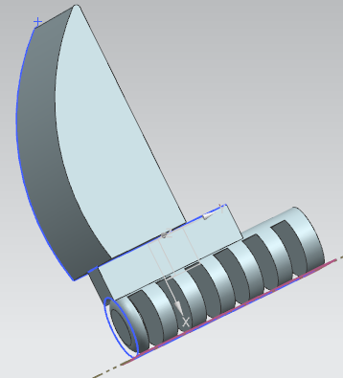
Modeling of parts – part 2
Fig: Inter-part Relation derived from the main part
Fig: Moving jaw - Part 2

Slide 14
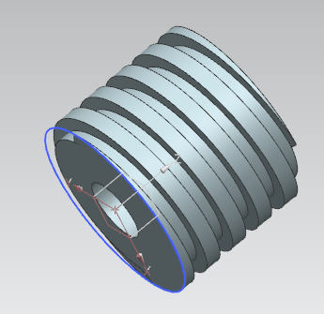

Modeling of parts – part 3 & 4
Fig: Part number 4 : Pin
Fig: Part number 3 : screw

Slide 15
Assembly of parts
First main body is imported to the assembly environment.
Moving jaw is loaded and aligned to the main body by applying constraints touch align option on the bottom face of the moving jaw and the top surface of the main body(as shown in figure) and then using align and lock option the axis of the screw in the moving jaw is made concentric with the hole diameter in the main body.
The pin is aligned such that the hole and the pin diameter are concentric and the end face of the pin touches the main body end face.
The screw is placed such that the internal diameter is concentric with the hole present in the main body and then the face of the screw thread is mating with the thread present in the moving jaw.

Slide 16
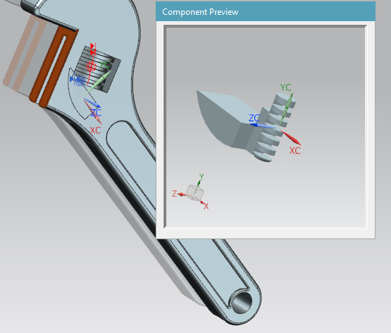
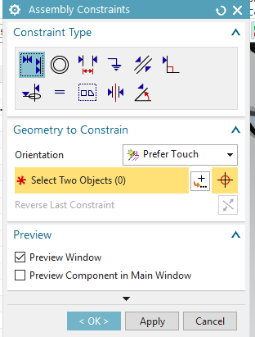
Assembly of parts – choosing constraints
Fig: Fixing of constraint's for assembly of parts
Fig: Fixing of constraint's for assembly of parts

Slide 17
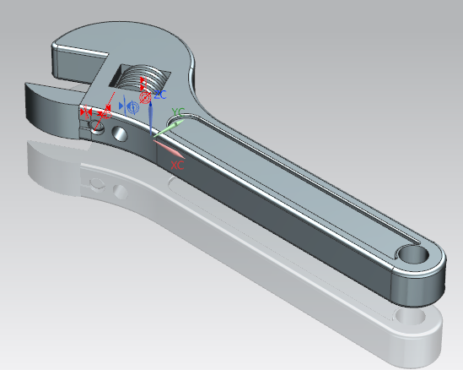
Assembly of parts
Fig: Shows the Assembled view of Adjustable wrench

Slide 18
Manufacturing of part
To decide on the manufacturing process of the product/component some of the assumptions need to be made. The number of parts that is required, the tolerance of each part dimensions and surface finish requirements.
It is assumed that the company needs to make 2000 pieces of this part
And since the tool is used on bare hands most of the time the surface finish of the tool has to be atleast 1.6.
The pin which fixes the screw and the hole in the main body is in interference fit.

Slide 19
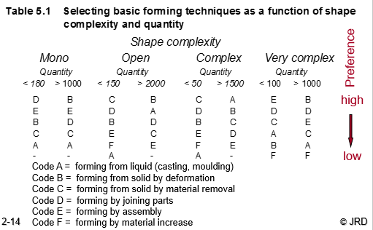
Manufacturing of part –selection of primary production process
Since the Part has some lateral features and has hollow volume inside the part is considered as very complex part and from shape complexity table the primary production process prefered is solid deformation and the second priority of the process is joining of pieces.

Slide 20
Primary process selection
In deformation process two methods are available bulk production and sheet metal forming. Out of these possible methods technologically possible methods is forging. Since the part need to be have more strength this method favored. First the part shape is cut from raw material and then it can be forged.
Different types of forging include Drawn out, upset forging or compression die forging. Here closed die forging operation is selected followed by trimming process.

Slide 21
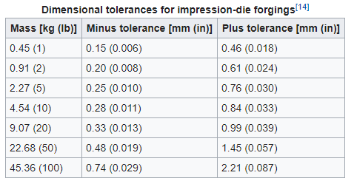
Primary process selection
one of the critical dimension in this part is the hole for insertion of the pin this is a interference fit which may be H7/s6 ^{[3]} for a pin of 4 mm diameter the tolerance 4 s6
corresponds to+19 to +27 and hole of 4 H7 corresponds to 0 to +12 micron
Fig: Showing General tolerance limits of closed die forging

Slide 22
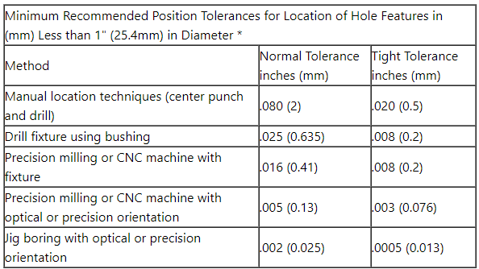
Manufacturing of part 1
Since the required tolerances is more closer than the tolerance achieved by the current selected process. So this requires some subsequent operations to be done on the forged component. Drilling is done for this process on a CNC machine15. And slot milling is required.
Fig: Tolerance value of drilling operation ^{[4]}

Slide 23
File Exchange test
In closed loop test the file is converted into a standard format such as IGES or STEP and then these formats are opened again in the same CAD software. From closed loop test following observations are made
In IGES format all the features are converted into a body and in STEP format the part is imported as one solid part there are no features present
The imported part doesn't have any expression this means Parametric modelling feature is not available anymore.
All rendering options are deleted.

Slide 24
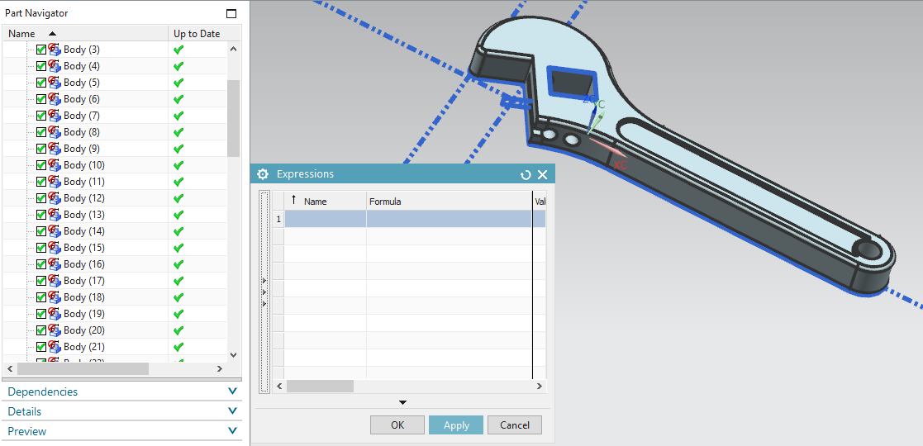
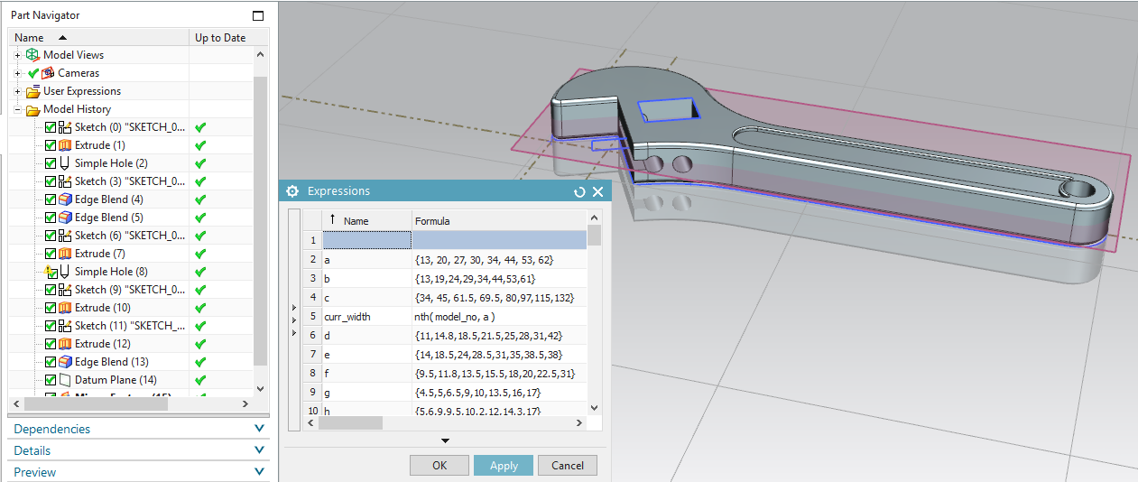
Closed Loop Testing – conversion to IGES Format
Fig: Part file created in NX with features and parametric modelling
Fig: Part file converted to IGES standard

Slide 25
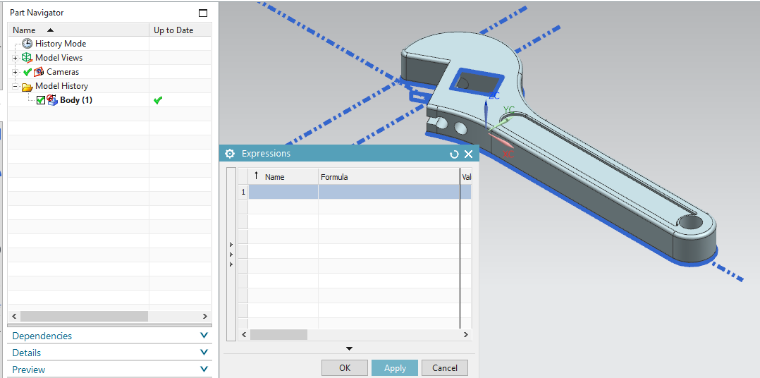
Closed loop test – conversion to STEP
Fig: Original Part file created in NX with features and parametric modelling
Fig: Part file after conversion from STEP conversion

Slide 26
Closed loop test

